Slide 1
Economics 144 Economic Forecasting
Lecture 13
Evaluating and Combining Forecasts
Part I (Theory)
Dr. Randall R. Rojas

Slide 2
Today’s Class
Introduction
Evaluating a Single Forecast
Testing Properties of Optimal Forecasts
Assessing Optimality w.r.t. an Information Set
Comparing Forecast Accuracy
Statistical Comparison of Forecast Accuracy
Forecast Encompassing and Forecast Combination
R Example

Slide 3
Introduction 1 of 6
Q: Can competing forecasts be combined to produce a composite forecast superior to all original forecasts?
A: Yes!
→ Main reasons for combining forecasts:
Many models or forecasts that have very similar predictive accuracy makes it difficult to identify a single best forecast.
Diversification gains.

Slide 4
Introduction 2 of 6
When should we combine forecasts?
Individual forecasts are misspecified
Unstable forecasting environment (e.g., past track record unreliable)
Short track record; use 1-over-N weights?
What should we combine?
Forecasts using different information sets
Forecasts based on different modeling approaches (e.g., linear vs. nonlinear)
Surveys, econometric model forecasts

Slide 5
Introduction 3 of 6
Advantages of combining forecasts
Dimensionality Reduction:
Combination reduces the information in a vector of forecasts to a single summary measure using a set of combination weights
Optimal combination chooses weights to minimize the expected loss of the combined forecast
More accurate forecasts tend to get larger weights.
Combination weights also reflect correlations across forecasts.
Estimation error is important to combination weights

Slide 6
Introduction 4 of 6
Successful Applications of Forecast Combinations
Gross National Product
Currency market volatility and exchange rates
Inflation, interest rates, money supply
Stock returns
Meteorological data
City populations
Sports (e.g., outcomes of football games)
Wilderness area use
Political risks
Estimation of GDP

Slide 7
Introduction 5 of 6
Two Types of Forecast Combinations
Data underlying the forecasts are not observed:
Treat individual forecasts like any other conditioning information (data) and estimate the best possible mapping from the forecasts to the outcome.

Slide 8
Introduction 6 of 6
Two Types of Forecast Combinations
Data underlying the model forecasts are observed: `model combination’
Using a middle step of first constructing forecasts limits the flexibility of the final forecasting model. Why not directly map the underlying data to the forecasts?
Estimation error plays a key role in the risk of any given method. Model combination yields a risk function which, through parsimonious use of the data, could result in an attractive risk function.
Combined forecast can be viewed simply as a different estimator of the final model.

Slide 9
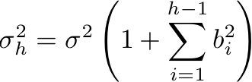

Evaluating a Single Forecast 1 of 2
Recall the Wold representation:
The h-step-ahead linear LS forecast:
The h-step-ahead forecast error
Variance

Slide 10
Evaluating a Single Forecast 2 of 2
Properties of Optimal Forecasts:
Optimal forecasts have 1-step-ahead errors that are white noise.
Optimal forecasts have h-step-ahead errors that are at most MA(h-1).
Optimal forecasts have h-step-ahead variances that are nondecreasing in h and that converge to the unconditional variance of the process.

Slide 11
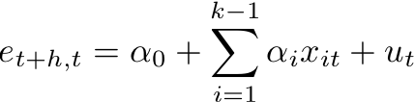
Assessing Optimality w.r.t. an Information Set 1 of 3
Unforecastability Principle: Optimal forecast errors should be unforecastable given the information available at the time of the forecast.
Consider a regression of the form:
where the hypothesis is that all α’s are 0. Optimality therefore implies that (α₀ ,α₁)=(0,0).
The regression of interest is therefore:
Notes:
If you can forecast your errors, that means there is still some dynamics that you have not get rid off that you forecasted.

Slide 12

Assessing Optimality w.r.t. an Information Set 2 of 3
Mincer-Zarnowitz Regression:
In this case, optimality implies that (β₀,β₁)=(0,1). Therefore,
→
i.e., (α₀ ,α₁)=(0,0) when (β₀,β₁)=(0,1)
The two approaches are the same!

Slide 13
Assessing Optimality w.r.t. an Information Set 3 of 3
Irrelevance Proposition
In a world with no model misspecification, infinite data samples (no estimation error) and complete access to the information sets underlying the individual forecasts, there is no need for forecast combination.

Slide 14
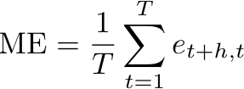
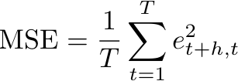
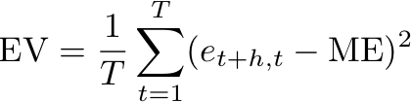
Comparing Forecast Accuracy 1 of 3
Popular Accuracy Measures
Let e_{t+h, t} = y_{t+h} – y_{t+h,t} and p_{t+h, t} = (y_{t+h} – y_{t+h,t} )/y_{t+h}
Mean Error:
Error Variance:
Mean Squared Error:

Slide 15
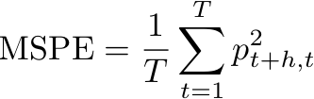
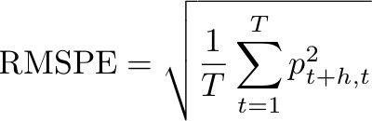
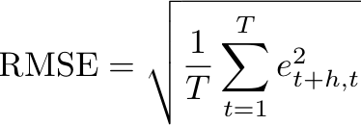
Comparing Forecast Accuracy 2 of 3
Mean Squared Percent Error:
Root Mean Squared Error:
Root Mean Squared Percent Error:

Slide 16
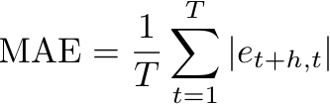
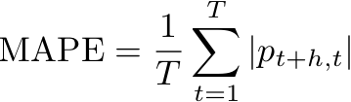
Comparing Forecast Accuracy 3 of 3
Mean Squared Error: MSE = EV + ME²
Mean Absolute Error:
Mean Absolute Percent Error:

Slide 17



Statistical Comparison of Forecast Accuracy
All accuracy measures are sample estimates of population accuracy.
Using Hypothesis Testing, we can test the Equal Accuracy Hypothesis: against the alternative that one or the other is better.
Equivalently, we can test the hypothesis that:
If d_{t} is covariance stationary, then:
where
Notes:
A and b are different forecast

Slide 18
Forecast Encompassing and Forecast Combination 1 of 3
Can competing forecasts be combined to produce a composite forecast superior to all original forecasts?→Yes
Forecast Encompassing Tests: Determine whether one forecast incorporates all the relevant information in competing forecasts.
Forecast Combination: There are two* main methods for combining forecasts:
Variance-Covariance
Regression ( )
*Technically, Variance-Covariance is a special case of Regression.

Slide 19


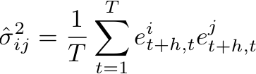

Forecast Encompassing and Forecast Combination 2 of 3
To find the optimal weight (ω*), we can minimize the variance of the combined forecast error:
You can replace with
Optimal combining
weight
→ We are forming a portfolio of forecasts!

Slide 20


Forecast Encompassing and Forecast Combination 3 of 3
Time-Varying Combining Weights:
Serial Correlation:
Nonlinear Combining Regressions:
Notes:
Suppose we change the frequency of the data, the best way to determine the weights is to use a time-varying weights since these weights would accommodate the time variance

Slide 21
For Next Class
Readings about today’s class:
Chapter 9ª, 12^{b}
Review Exercises / Problems:
Chapter 12^{b}: 1, 3, 5, 9, 11
Readings for next class:
Chapter 13^{b}, 10ª

